Slide 1

Rockbuster Stealth Data Analysis
By Victoria sosunova

Slide 2
Purpose
In order to stay competitive from streaming services such as Netflix and Amazon Prime, the Rockbuster Stealth LLC, a movie rental company, is planning to use its existing movie licenses to launch an online video rental service.
The purpose of this presentation is to present findings on high grossing regions, customers, and movies that will help lead strategy in launching the online rental service. This presentation will address the following questions:
● Which countries are Rockbuster customers based in?
● Where are customers with a high lifetime value based?
● Do sales figures vary between geographic regions?
● Which movies contributed the most/least to revenue gain?
● What was the average rental duration for all videos?

Slide 3
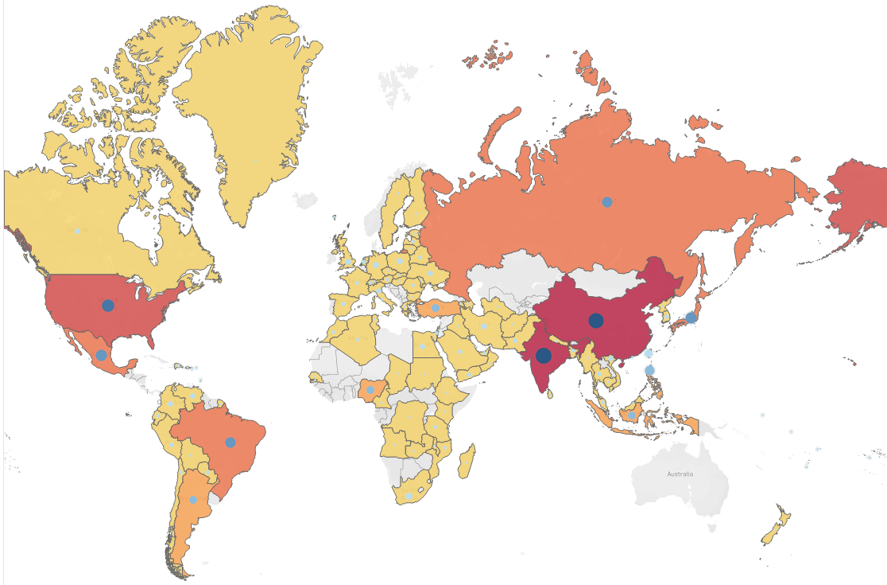


Geography of Rockbuster customers The higher the number of customers, the higher the revenue in the region.
The top five countries with the highest revenue:
India $6,035
China $5,251
United States $3,685
Japan $3,123
Mexico $2,985

Slide 4
Customers with a high lifetime value
Customer ID | First Name | Last Name | Country | City | Total Spent
566 | Casey | Mena | Turkey | Tokat | 130.68
84 | Sara | Perry | Mexico | Atlixco | 128.7
506 | Leslie | Seward | Indonesia | Pontianak | 123.72
389 | Alan | Kahn | China | Emeishan | 119.75
537 | Clinton | Buford | United States | Aurora | 98.76
Rockbuster’s top customers are spread out across the globe.

Slide 5
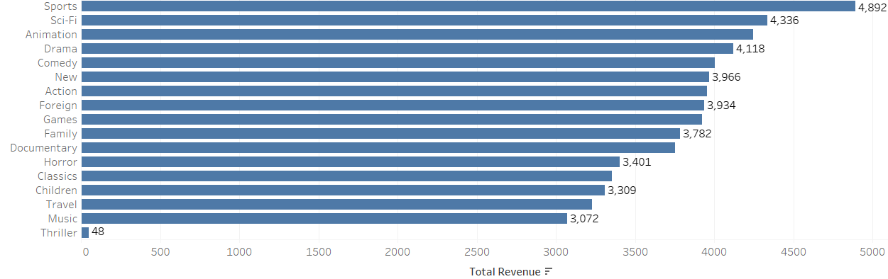
The most profitable movie genres
The highest grossing movie genres are sports, sci-fiction, animation, drama, and comedy.

Slide 6
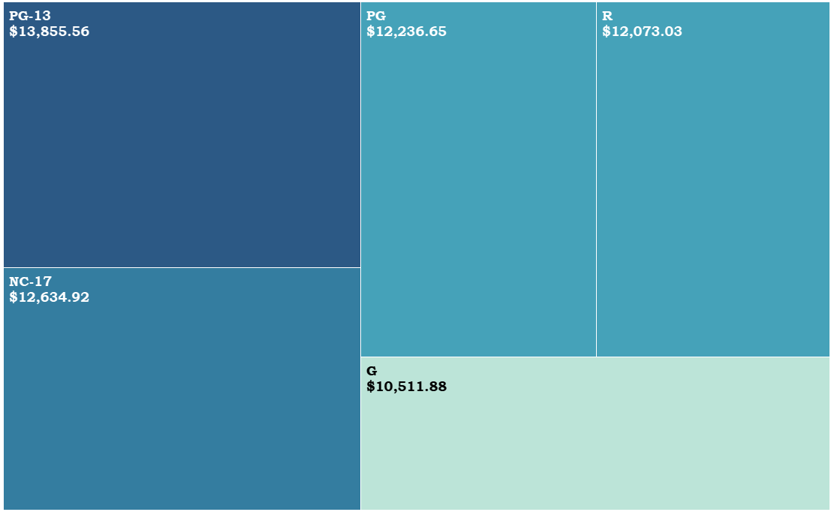
The most profitable movie ratings
The most profitable rating is PG-13. G-rated movies are the least profitable. Overall, the revenue by rating shows relatively equal distribution of profit.

Slide 7
Rental duration and rate
 | Rental Duration | Rental Rate
Min | 3 | $0.99
Max | 7 | $4.99
Average | 5 | $2.98
Rental Rate | Number of Rentals
$4.99 | 5,272
$2.99 | 5,120
$0.99 | 5,652
The average rental duration is 5 days, the average rental rate is $2.98.
No impact of rental rates on the number of rentals is discovered.

Slide 8
Recommendations
Retention
Create loyalty program based on number of movies rented monthly. Reduce rates for new customers and release bonus programs for the existing members.
Growth
Focus on the leading markets with high revenue and high numbers of Rockbuster customers. Organize marketing campaigns according to the most popular movie categories and ratings. Analize revenue and rentals, and customers’ preferences on a quarterly basis.
Release strategy
Highlight the most popular genres and titles on the platform in order to attract the customers’ attention. Analize the impact of rental rates on customers’ behavior. Changing of the rental rates may significantly influence the company’s revenue.

Slide 9

Questions?
Email: midovics@hotmail.com
Sources:
Rockbuster Revenue Analysis| Tableau Public
https://1drv.ms/p/s!Ag2EjakUYDenoC41yvS0-IpZyvzt?e=9sa90O
3.10 Presenting SQL Results.xlsx

